Slide 1
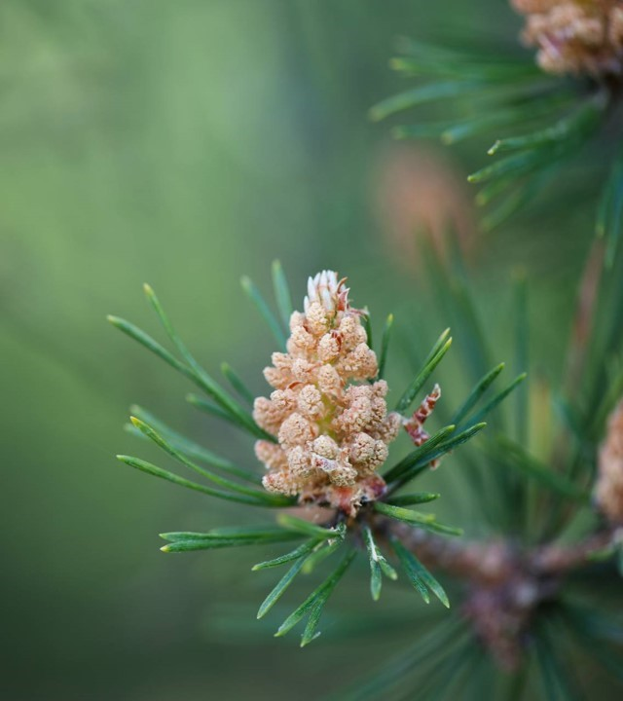
Moffat Bay Lodge
Jaci Brown Austin Moore
Jon Green
Nilam Abdul-Haqq

Slide 2
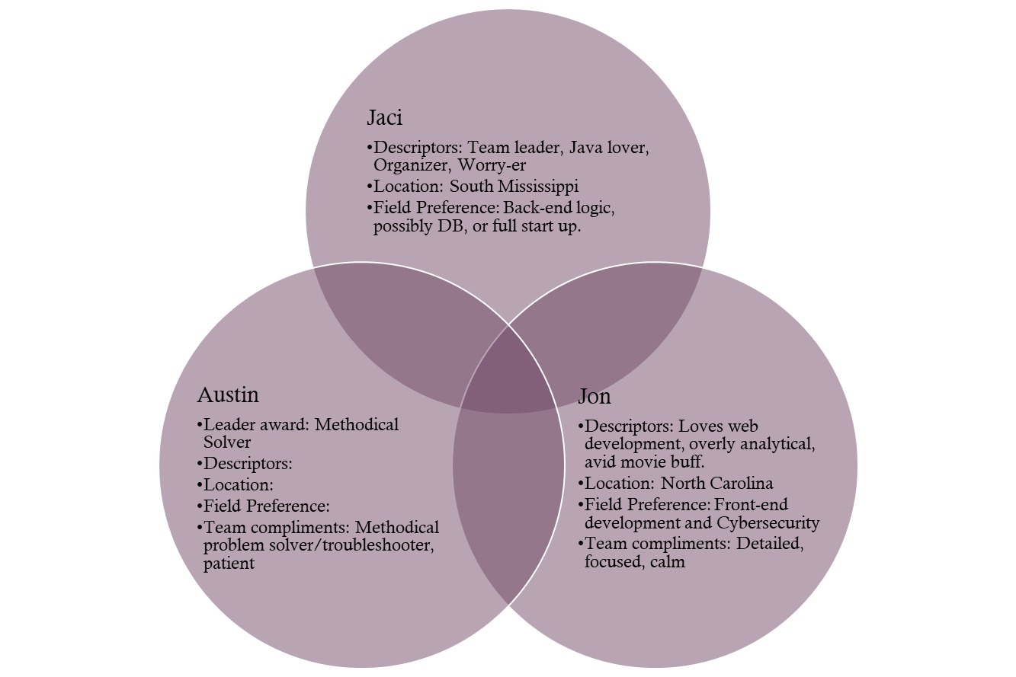
About the team
Descriptors: Team Leader, Java lover, Organizer, Worry-er Location: South Mississippi Field Preference: Back-end logic, possibly DB or full startup
Jaci
Descriptors: Loves web development, overly analytical, avid movie buff Location: North Carolina Field Preference: Front-end development and Cybersecurity
Jon
Descriptor: Lover of Python, Web Design, and Crafts. Location: South Carolina Field Preference: Front-End Development and Python
Nilam
Descriptors: Problem Solver, Collaborative, Continuous Learner Location: Colorado Field Preference: Front-end development, Python
Austin

Slide 3
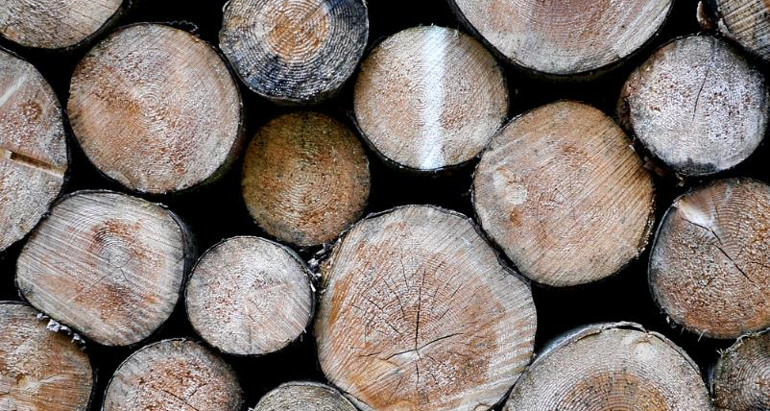
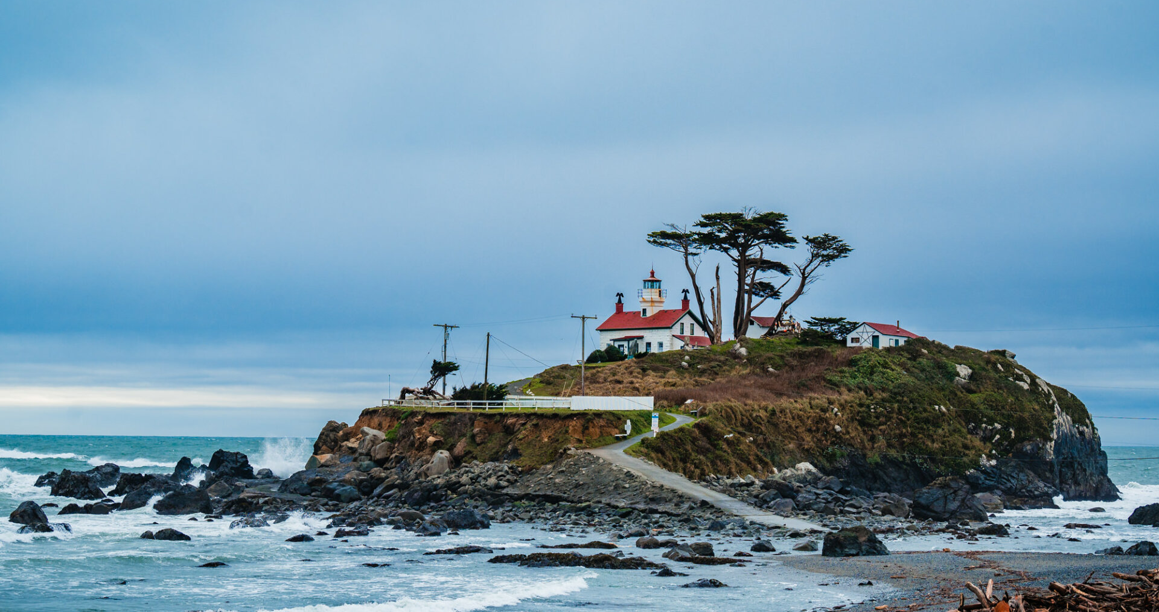
Design process
While building a website to represent Moffat Bay Lodge, we considered the surrounding area carefully. We wanted to bring to life the spirit of the experience here on Joviesda Island.

Slide 4
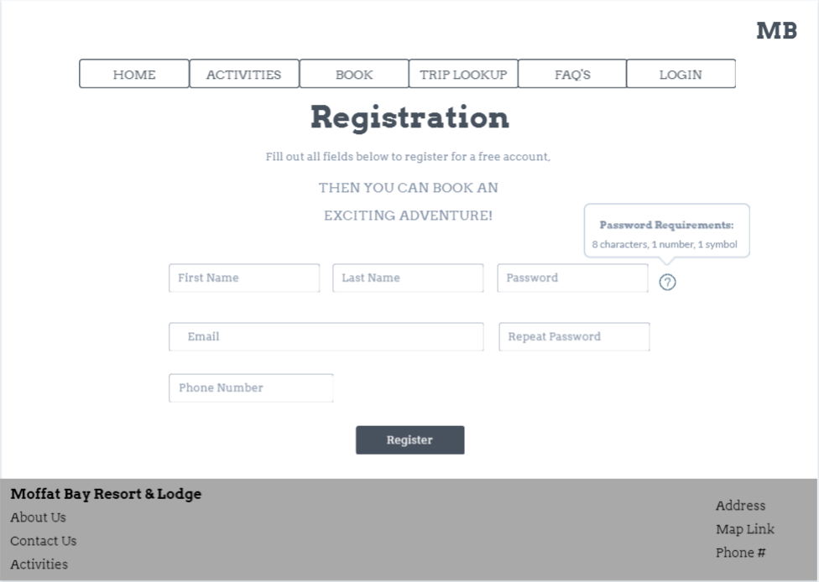
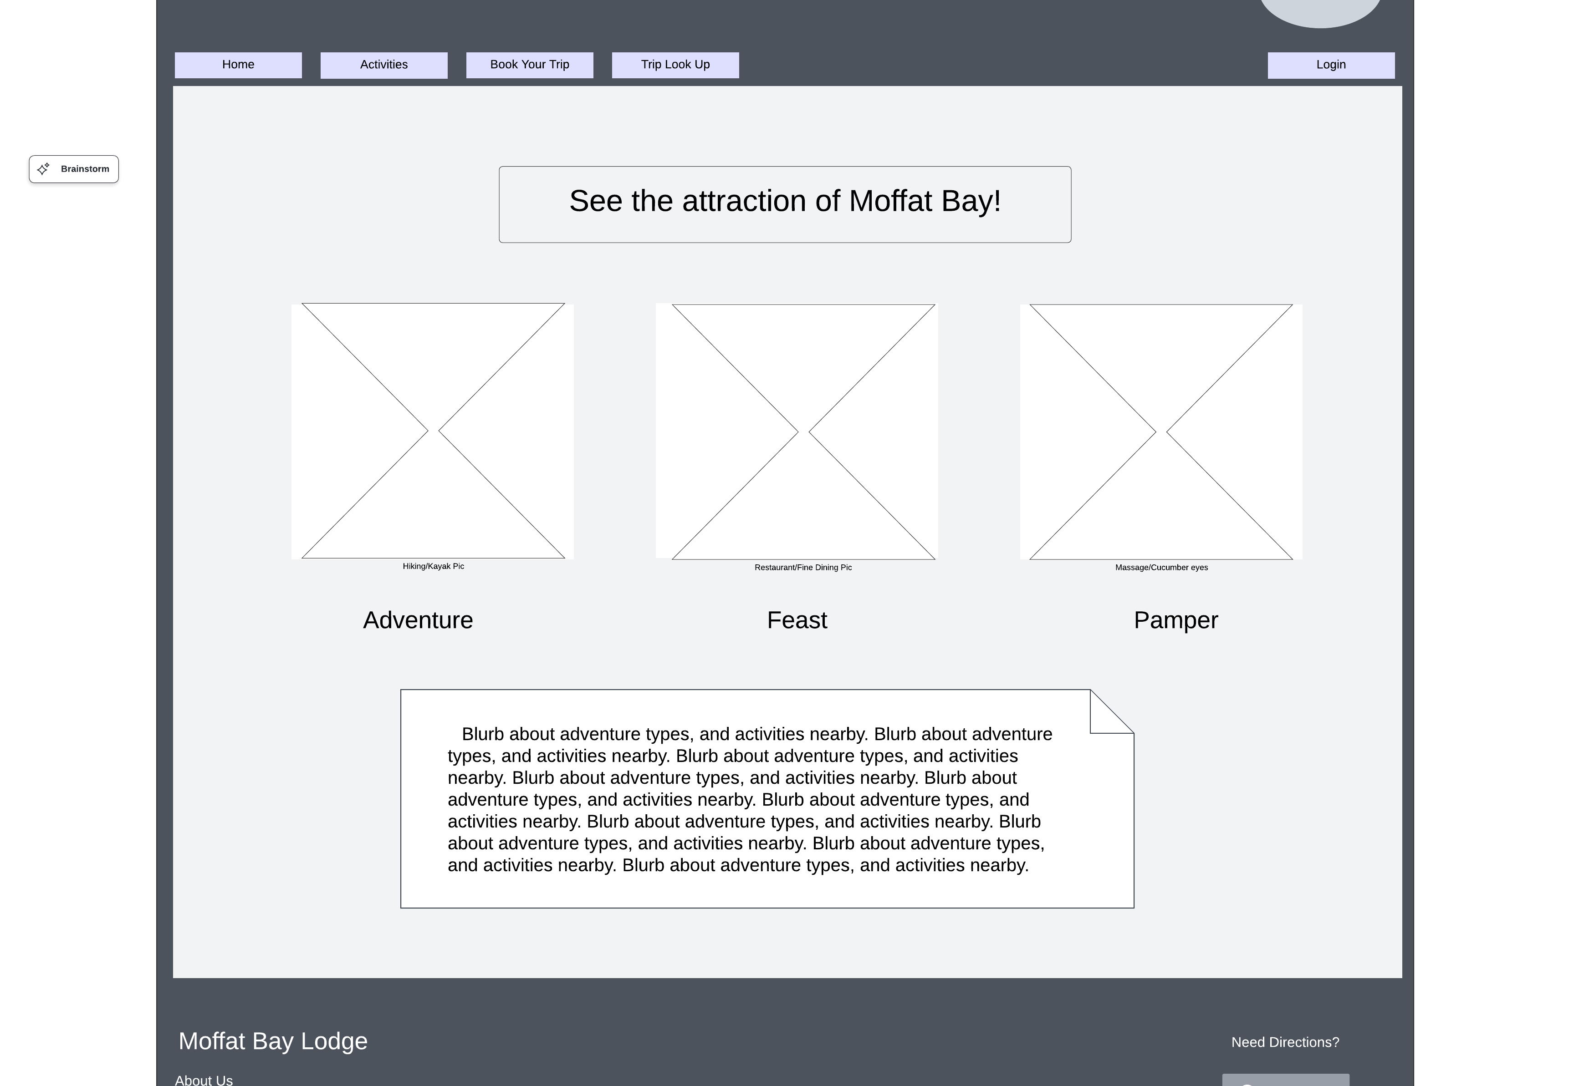
Rough prototypes
Initially, our designs were very basic. We naturally aligned to having contrast for text and menu bars. The goal was to have a mental image to hold while coding, and a way to see the requirements visually.

Slide 5
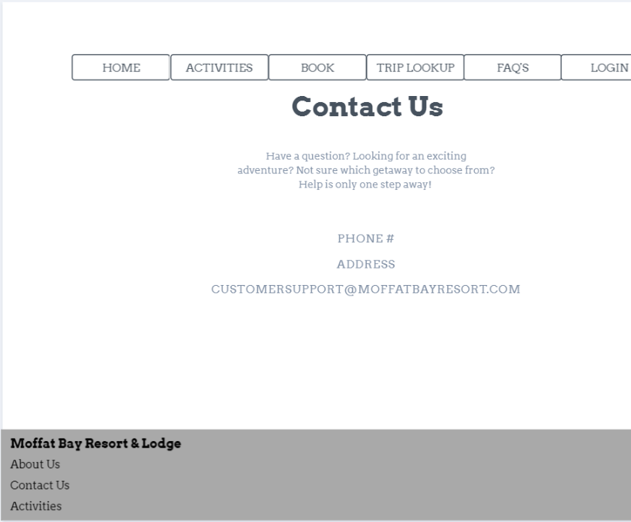
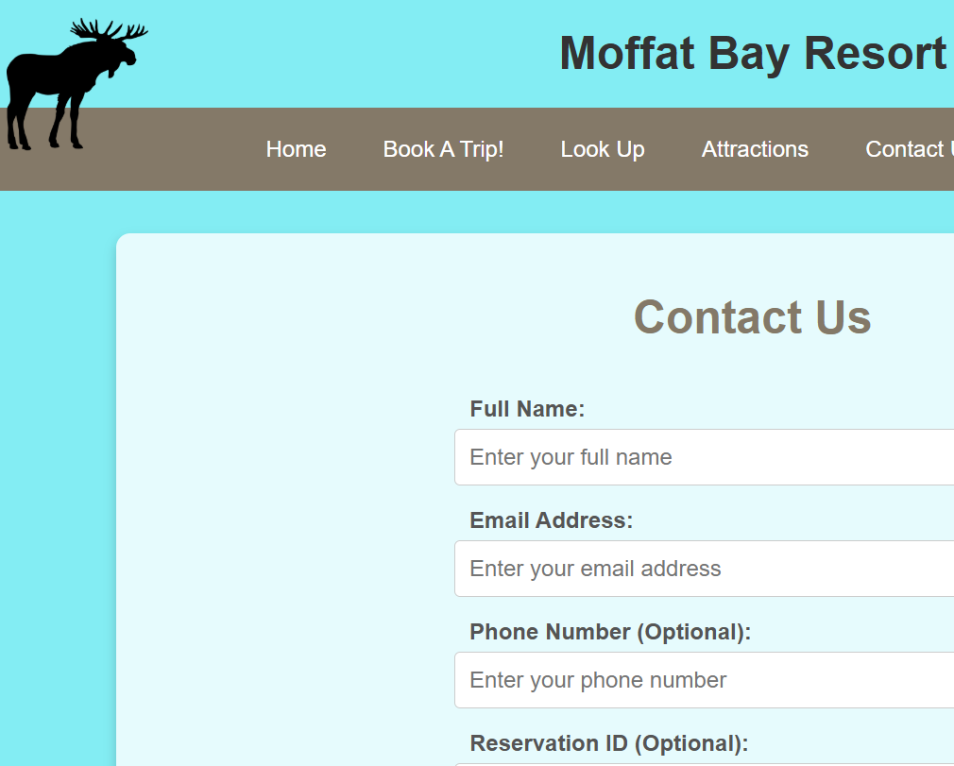
Prototypes in action:
Some of the designs evolved as we settled on a cohesive style. Representing consistency was often highlighted to increase customer trust.

Slide 6
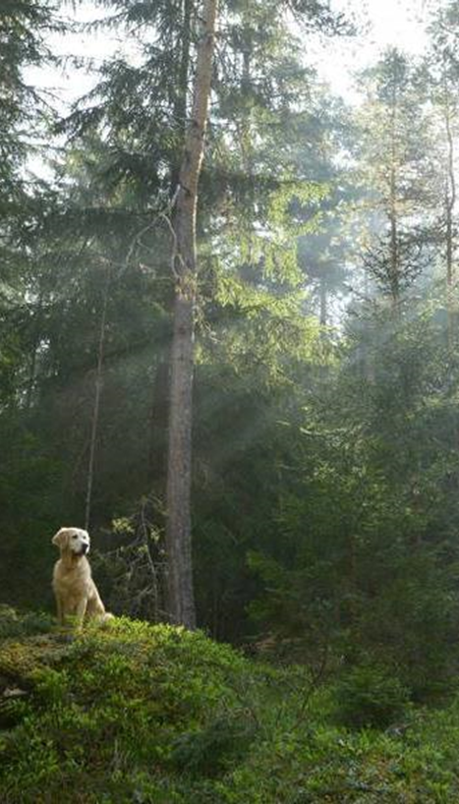
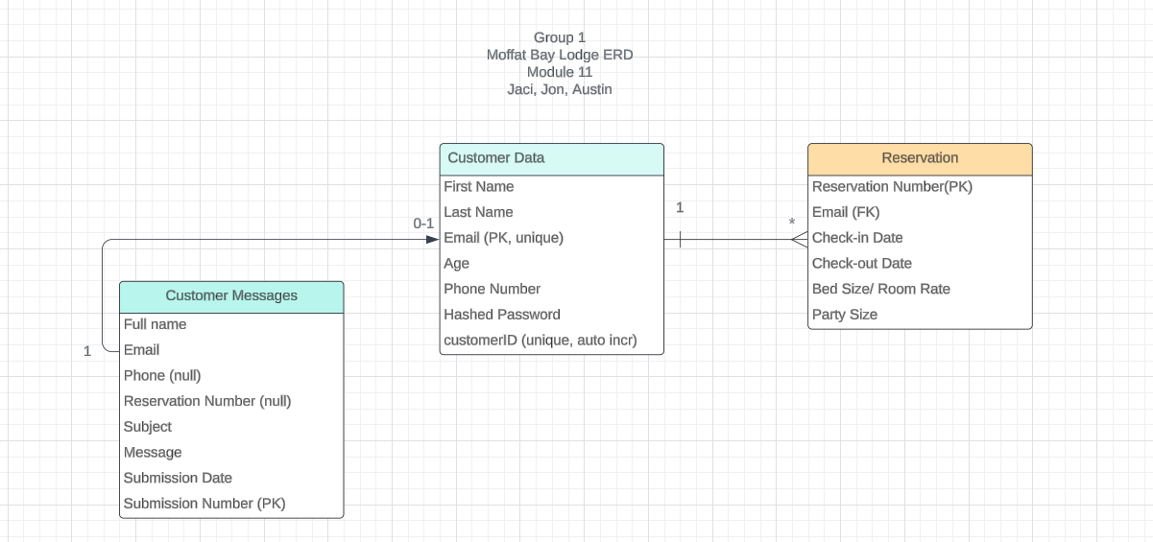
ERD AND TESTING
Our design initially only included customer data and reservations. As we began working, we soon realized we had overlooked storing the messages from the contact page. However, it was an easy addition to make.

Slide 7

Test cases

Slide 8
Test case #1 – Contact us submission page summary
The goal of this test is to ensure that the Contact Us page loads when the directional hyperlink is clicked from any of the corresponding webpages in the navigation bar. We also want to ensure that all of the graphics and HTML content populate successfully on the webpage. In our tests, we were able to successfully load and navigate the Contact Us page by clicking on one of the corresponding hyperlinks. In addition to the site loading, we were also able to confirm that the user was able to populate and enter data into the input boxes. The submitted data was then transmitted and stored within our database for later use. All backend programming logic worked as intended as the front-end successfully communicated with the backend to transmit data.

Slide 9
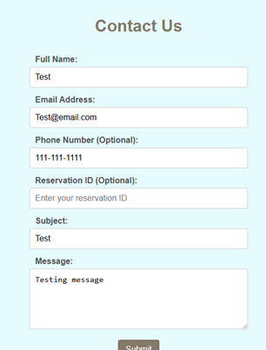
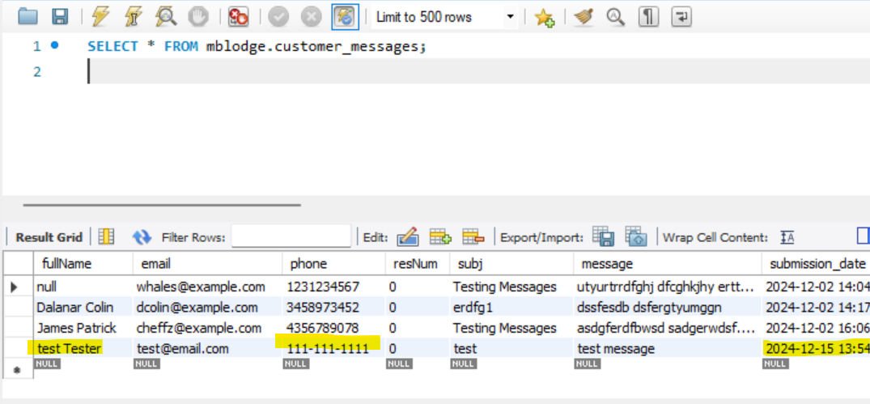
Test case #1 – Results
The name test produced an error, because the form expects a space between your first and last name.

Slide 10
Test case #2 – Creating a reservation
The purpose of this test is to simulate a user successfully creating a reservation after loading the reservation page. In our testing, the user was able to input information into the data fields and submit the information to our database. The test confirmed that all required user fields were functional, and that the user could not proceed while the fields were left empty. The programming logic prevented empty data fields from being submitted by the user. We were also able to confirm that the various options for the cabin / bed type were available along with displaying the corresponding prices. The database successfully stored the user submitted data, and the user was then sent to a confirmation page afterwards. The confirmation page contained the Reservation ID along with all of the details contained within the completed reservation.

Slide 11
Test case #3 – reservation search test
In this test, we are attempting to retrieve a previous user created reservation. The method used for conducting the test was searching with a predefined Reservation ID that was already stored within our database. The goal is to simulate a user attempting to retrieve data from a previously booked reservation. The test was comprised of the developer entering a reservation ID into the search field. There are other search options available on the site, however, we chose the predefined Reservation ID for simplicity of the test. Our test was successful in that we input the Reservation ID and were able to retrieve the stored information from our database. Once the site is in production, the user will be able to search by Reservation ID, name, email address, or phone number.

Slide 12
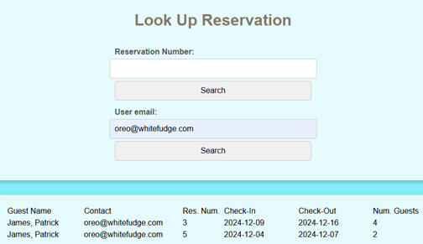
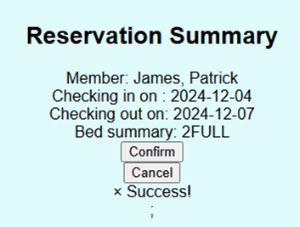
Test case #2 & 3– RESULTS

Slide 13
Test case #4 – login page validation
We attempted to evaluate the programming logic pertaining to accepting user credentials in order to grant user access. In the test, we entered a username and password in order to simulate a user logging into our website. We confirmed that the user was unable to log in until all required data fields were populated. In addition, we also confirmed that the login attempt was rejected if the data did not match information currently stored within our database. On the failure attempt, the user was supplied with an error message indicating the reason for the failure. The test was successful as it only allowed users to gain login access to the site if the user supplied login credentials were matched to the data stored within the database.

Slide 14
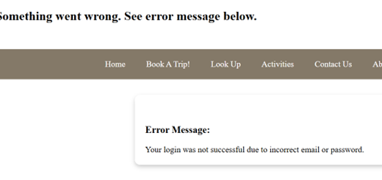
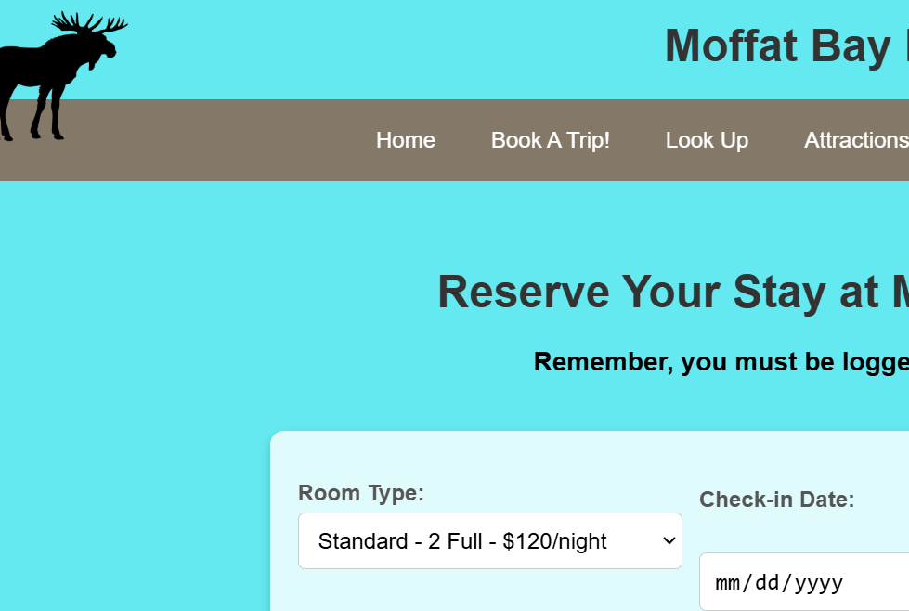
Test case #4 – Results

Slide 15
Test case #5 – landing page functionality
In order to ensure that the users were successfully able to visit our site, we conducted a landing page functionality test. The test was comprised of verifying that all HTML and CSS elements successfully loaded upon page generation. The team confirmed that the landing page populated with various images and links highlighting various aspects of the resort. Another component of the test was to ensure that each hyperlink that was included within the navigation bar was completely functional and directed the user to the corresponding webpage. We evaluated several different hyperlinks and successfully loaded the corresponding pages inside of a new browser tab on the attractions page only, to prevent customers from losing their place.

Slide 16

Screen captures of site

Slide 17
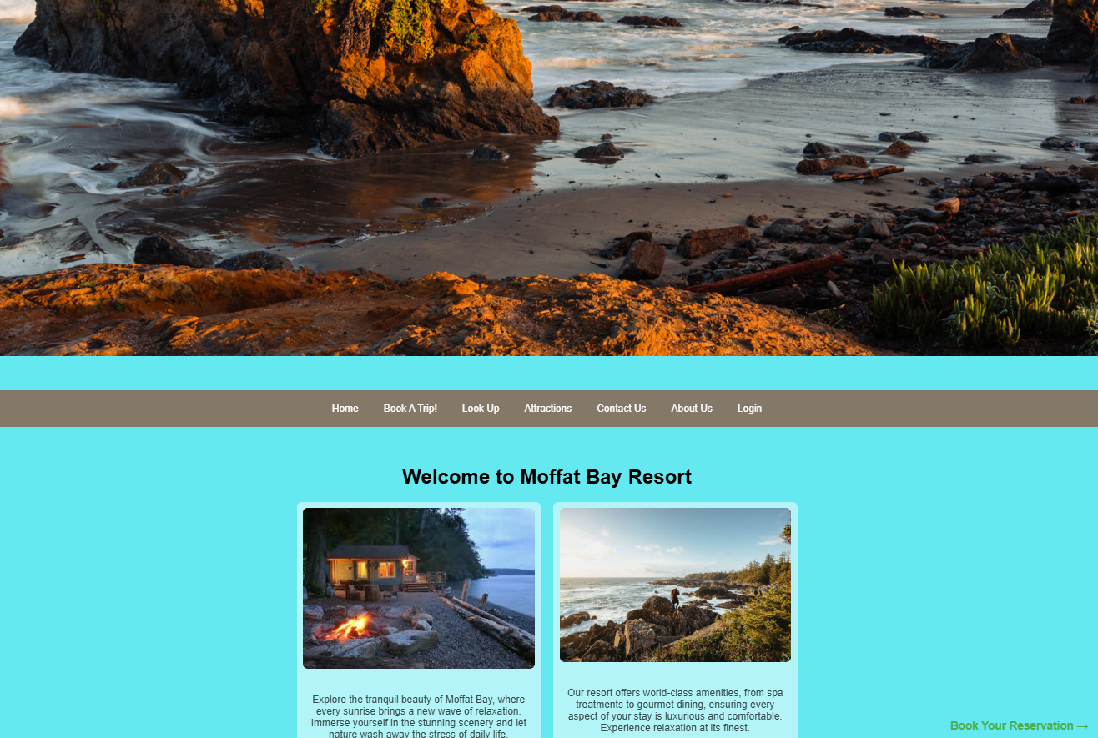
Landing page
Main picture is to capture the customers attention, showcasing amazing views by the resort. Home page has header bar along with other pictures and details of the resort overall.

Slide 18
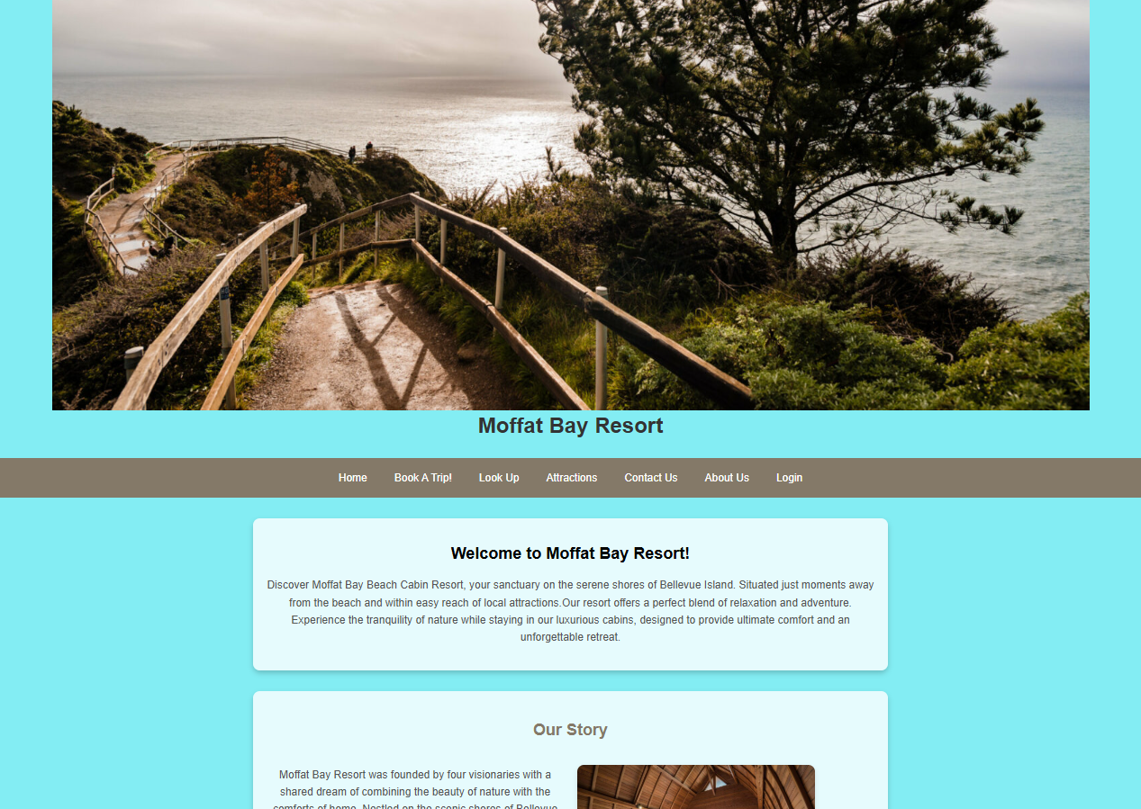
About us page
Different view of the resort at the top of the page. About Us gives more of a story and what you can experience while here along with a booking button at the bottom of the page after reading through an immersive experience.

Slide 19
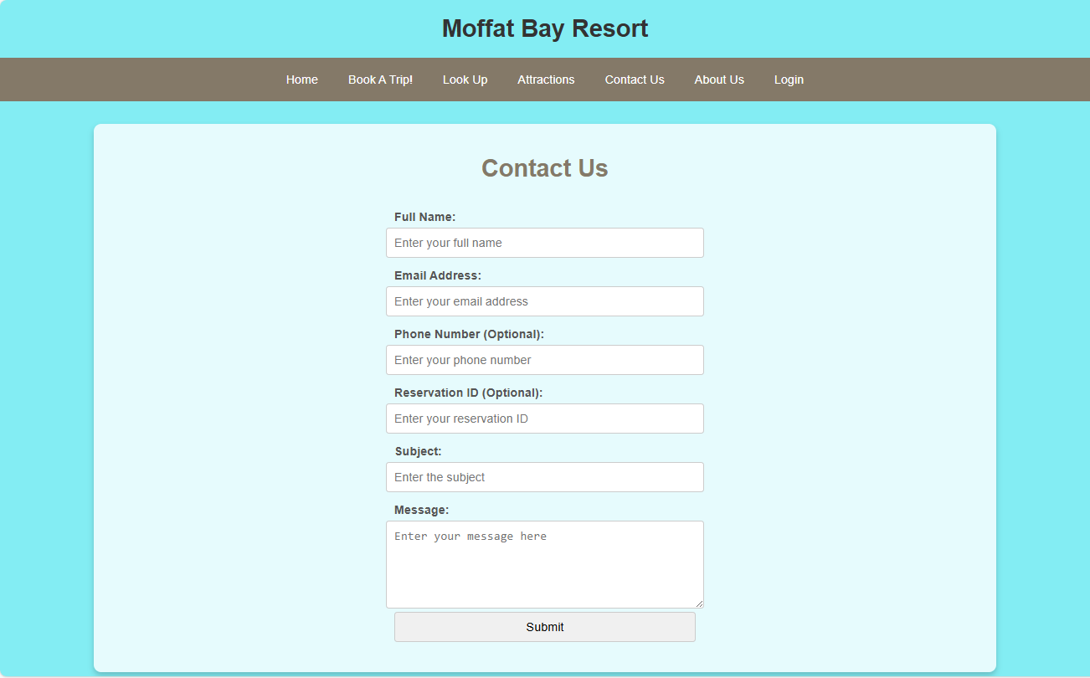
Contact us page
Contact us allows us to get in touch with you – just enter some information so we can reach out!

Slide 20
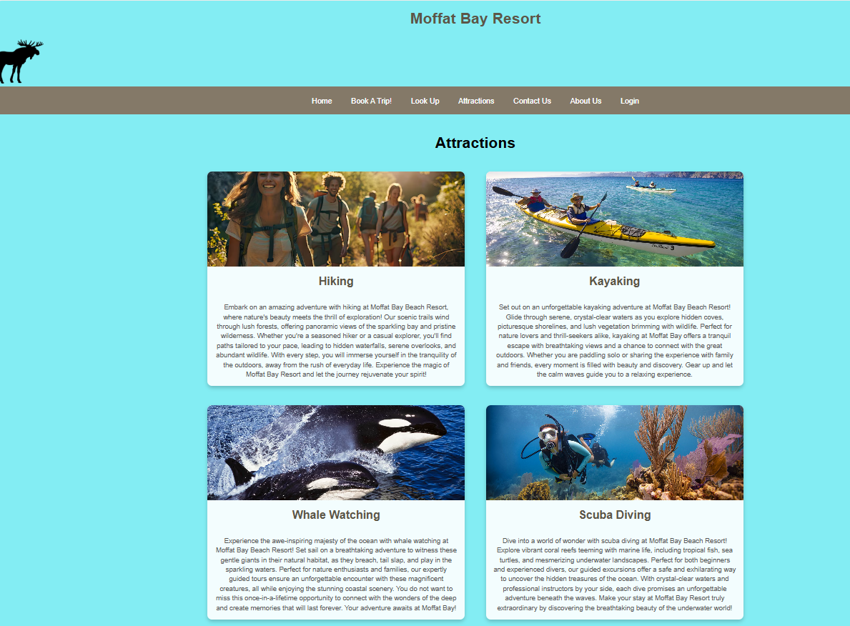
Attractions page
Attractions gives more insights to what you can experience while you stay at our resort.

Slide 21
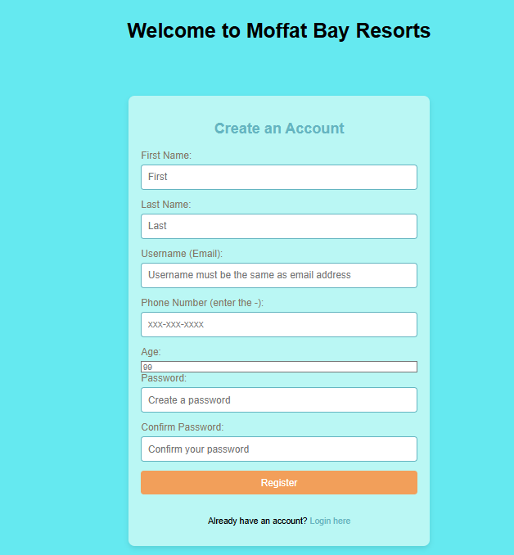
Registration page
Create an account here so you can sign in, make a booking, and lookup any existing booking.

Slide 22
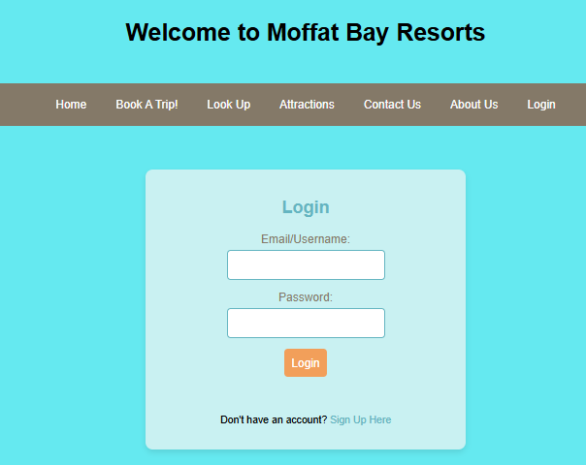
login page
Login here to make a booking and see your existing bookings.

Slide 23
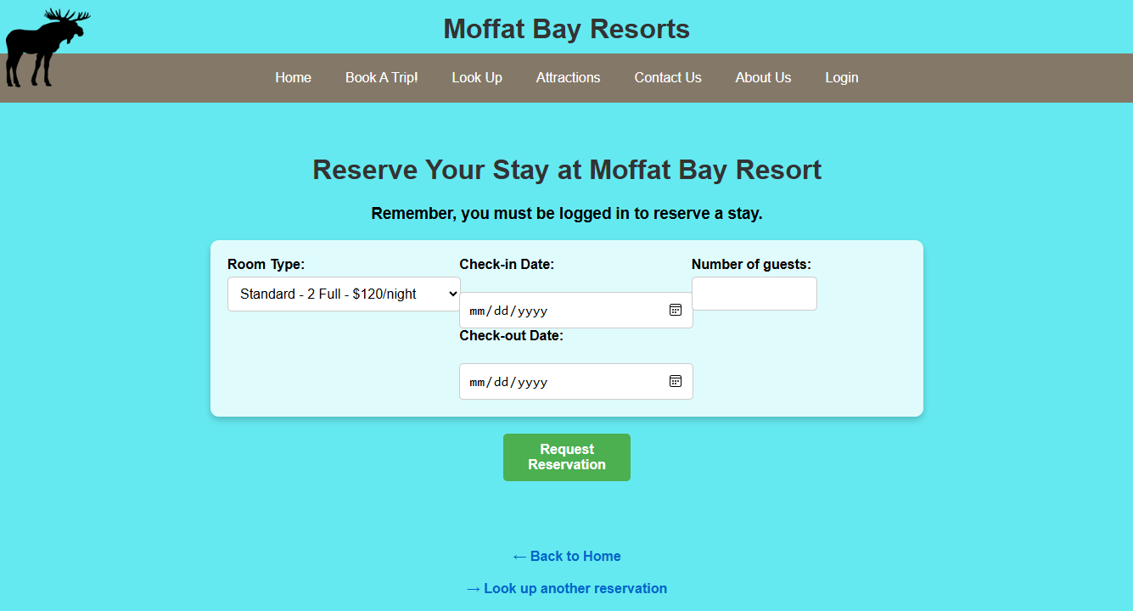
reservation page
Choose between 4 rooms (Standard, Deluxe, Formal and Presidential). A user-friendly drop-down calendar allows for easy choosing of dates.

Slide 24
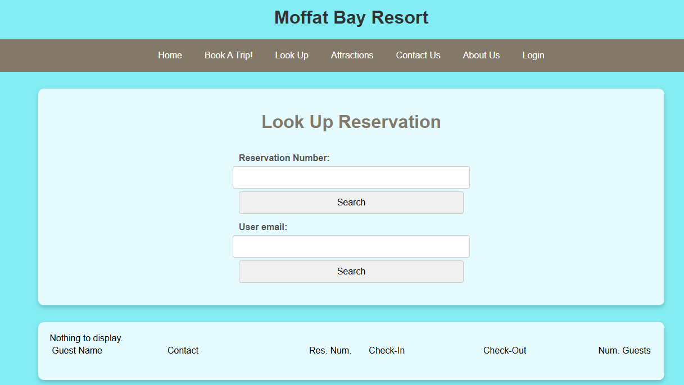
Lookup Reservation & summary page
Look up your reservation here to see your reservation number along with the details about your booking. You can look it up either through a reservation number or your email. You will only be able to access reservations made under the current logged in email.

Slide 25
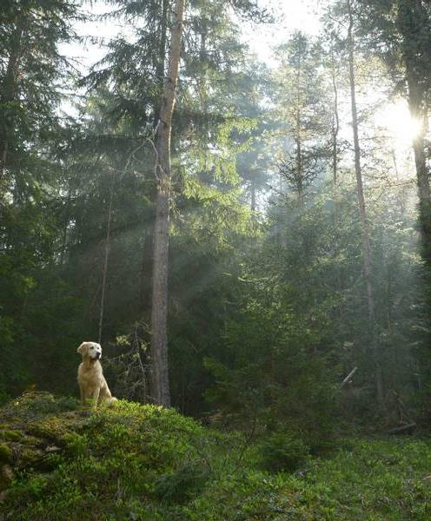
Lessons Learned
Team Environment – learning to work with each other, understand deadlines better, and overcoming obstacles
Communication – working with each others' schedules, consistent routines and assignments of tasks and realistic goals and expectations of these tasks
Dependency – learning to rely on others to complete certain tasks
Future Outlook – this project has given better insights on what may be expected in a real-world job
Software Setup – Admin errors when using software causing the program not to run properly > specific settings within eclipse itself
Time Management – Work and School conflicts created some burdens and delays in certain completion timelines
Collaboration – Group board in blackboard not as user friendly as Discord > switched early on to have better collaboration

Slide 26
Thank you
https://github.com/JKBrown11/Moffat-Bay
Jaci Brown
Austin Moore
Jon Green
Nilam Abdul-Haqq

